Slide 1
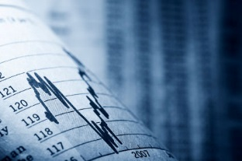
The Futures Market
Image Source: http://www.online-futures-trading.co.uk/files/u1/futures_trading4.jpg

Slide 2
The Futures Market
The Futures Market is a centralized market for trading futures contracts.
  A futures contract is a contract to buy a commodity.
  A commodity is usually thought of as a raw material for producing a good.
    Examples of commodities include crops such as corn or wheat, animal products such as beef or pork, coffee, oil, lumber, gold, and more.
The Futures Market ensures that producers can sell their products for a predictable price, consumers can purchase the products for a predictable price, and the general public can potentially make a profit through investment in the exchange of contracts on the open market.
  The Futures Market is a venue to allow more price stability, create price predictability, and enable outsider investment.

Slide 3
The Futures Market
The Futures Market is sort of like a cell phone contract.
  When you enter into a cell phone contract, you are agreeing to pay so much for a year in order to receive a certain number of services (cell phone minutes, texting, data plan, etc.).
When you enter into a cell phone contract, you are ensuring that your prices stay the same for the length of your contract.
  Even if the price of other cell phone data plans rise, you would still pay the same price you agreed to when you signed the contract.
  The same is unfortunately true if the price for another company drops – you will still pay the comparatively higher price until your contract ends.

Slide 4
Futures vs. Cell Phones
The Futures Market is like a cell phone contract.
  Instead of the cell phone company, you have a farmer trying to sell a crop.
  Instead of a regular person trying to get cell phone service, the person paying in
  the contract might be a large
  national bakery.
  Instead of cell-phone minutes,
  it might be wheat.

Slide 5
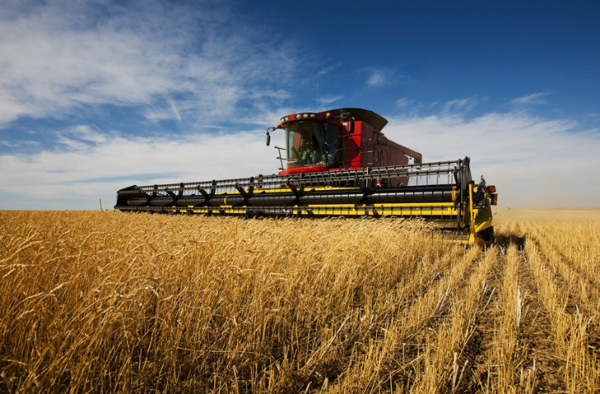
Futures Market E.g.
Imagine that a farmer and a bakery enter into a futures contract requiring the farmer to deliver 10,000 bushels of grain in July at a price of $5 per bushel.
  By having this futures contract, the farmer and the bakery ensure that they each have a price they can use for financial planning.
  They can both ensure that this price meets the equilibrium point between the need from the farmer for adequate pay and the need of the baker for affordable flour.
  Rather than the farmer not knowing
  what he’ll make in July for his crop
  and the baker not knowing what the
  cost of his wheat will be, both can plan
  for their sale months before the wheat
  even ready to harvest.

Slide 6
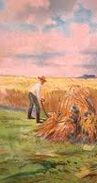
History of Futures
The Futures Market began out of economic necessity.
  In the 1800s, a grain farmer in the Midwest usually went to Chicago to try and sell their crop.
    Every farmer (or a broker who represented them) would try to sell their grain shortly after the harvest.
  This increase in supply meant that prices dropped to their lowest when harvest met its peak.
    At the end of harvest, unsold crops would rot for weeks in the streets of Chicago.
Source; http://4.bp.blogspot.com/-vYX9uRxYPy8/Tnyu9CtQj4I/AAAAAAAABLk/O-XBkokdQ5c/s1600/Harvest%2B1800s.jpeg

Slide 7
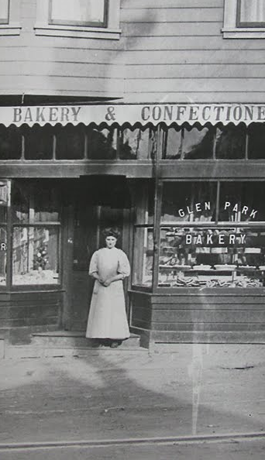
History of Futures
Farmers were not the only ones who faced problems with this system.
  Merchants at this time did not have dependability.
  They couldn’t accurately predict how much grain they’d be able to buy and sell.
    They couldn’t forecast the markets; they had no idea whether the prices they paid would be too high, too low, or just right.
    They also had no way of knowing whether the supply of grain would be plentiful or scarce.
  They didn’t even know if they grain they bought would even be delivered!
    A farmer might find a buyer who would pay more for their crop, and the farmer might back out of a contract without even informing the buyer.
Source: parishotelboutique.blogspot.com

Slide 8
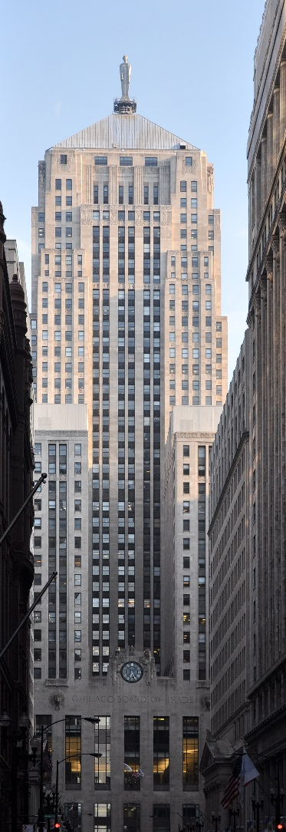
History of Futures
In 1848, the Board of Trade was created in Chicago.
  The Chicago Board of Trade was a member-owned business that offered a centralized location for the selling and purchasing of commodities.
  Farmers had a place to ensure a fair price for their goods, merchants had a place to obtain the best price for their raw goods, and all exchanges were regulated to ensure fair business practices.
This system made the process much more effective. Because the system was more effective, it became overwhelmed by its own popularity.
  Instead of individual contracts (each with their own individual details), the Board of Trade was changed so that every contract was exactly the same in terms of quantity, quality, and delivery.
  The only negotiable items were a) the number of contracts, and b) the price for an individual contract.
Source: http://upload.wikimedia.org/wikipedia/commons/3/3d/Chicago_Board_Of_Trade_Building.jpg

Slide 9
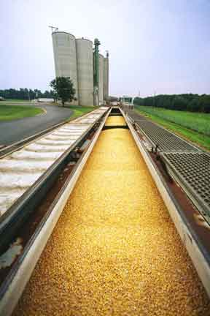
Futures Contract
Contracts today are required have each of the following components:
  Quantity – e.g. 5000 bushels of corn
  Quality – e.g. #2 Yellow or #3 Yellow corn
  Month of Delivery – e.g. July
  Terms of Delivery – e.g. Physical Delivery by Rail
  Price – negotiable
  Volume – the number of contracts to be purchased (also negotiable).
Source: http://www.go-explore-trans.org/wp-content/uploads/images/cars_corn_mill.jpg

Slide 10
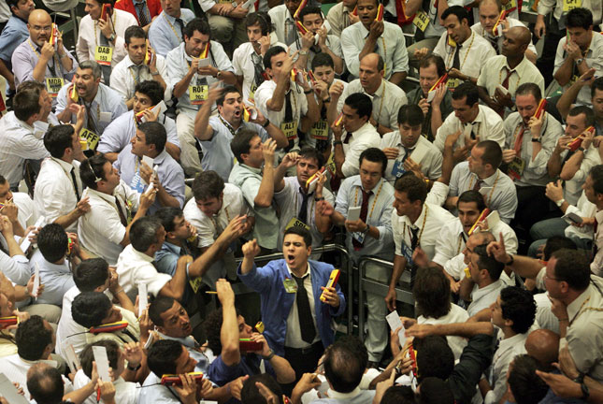
Venue for Price Discovery
As a result of this system, the futures contract is a ‘venue for price discovery.’
  This means that a farmer could predict how well they could do with a crop based on whether that crop was trading well or not.
    This is valuable information when deciding what to plant months before that crop will be sold.
Prior to the existence of the Board of Trade, you or a representative had to physically go down to Chicago and negotiate a price.
  With the existence of the Board of
  Trade, you only had to look at a
  newspaper to determine what the
  price of a commodity was trading at.
  Due to the large volume of trading in
  one location, prices became public
  knowledge rather than something
  decided on a case-by-case basis.
Source mediagallery.usatoday.com

Slide 11
Futures Price Mechanisms
The Futures Market is able to determine a price based on the numerous factors that influence buyers’ and sellers’ ideas about what an ideal price would be.
  In January, for example, a futures contract would reflect the consensus of all of the buyers’ and sellers’ ideas on what the price of a commodity (such as corn) will be in July.
  A prediction that the summer will be unusually dry or a report that a storm is causing a shortage of corn in Brazil will change these ideas, causing a shift in the average price sought for a July corn contract.
  Thus, the price of a contract is a product of what buyers and sellers think the price will be in the future, and this price will change as new information becomes available until the contract date is reached.
The changes in the price of a commodity will also affect future changes in a commodity.
  For example, if the price of corn drops one day, more buyers will be interested in purchasing the corn and fewer sellers will want to sell that corn.
  This increase in demand as a result of the price drop could actually cause the price to increase as supply is reduced and demand increases.

Slide 12
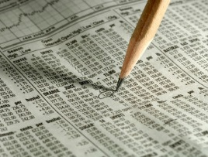
Purpose of Futures
The primary purpose of the Futures Market is to establish a price now for products that will be delivered later.
  For a farmer, this means that they can ensure that they will receive a specific price when their crop is harvested later, enabling the farmer to make plans and predict their final profit.
  For a consumer, such as a large producer of baked goods, it ensures that a product can be purchased at a predictable price, allowing this consumer to plan around expenses.
  This reduces the risk and increases the
  predictability for both the farmer
  supplying the product and the consumer
  purchasing the product.
  The people who use the Futures Market
  to reduce their risk are called Hedgers.
Source: www.life123.com

Slide 13
Hedgers are individuals or firms who make purchases or sales in the futures market in the hopes of establishing a price for a product that will be sold weeks or months in the future.
  Hedgers protect themselves from an unfavorable price change in the future (either a price drop for a producer or a price spike for a consumer) by locking themselves into a contract for a set price that works for their needs.
  If you are a rancher, you may use a contract to ensure you get a certain price for your beef in case the price of beef drops between the birth of the cattle and their slaughter.
  If you are crop farmer, you can use the futures market to ensure that the crops you are planting in spring will still be profitable in fall.
It is possible that if you are a farmer, the price could rise after you signed a contract, causing you to lose more money than if you had no contract whatsoever.
  However, the assurance that you will receive a set price when you sell allows you to plan for the future without as much worry.

Slide 14
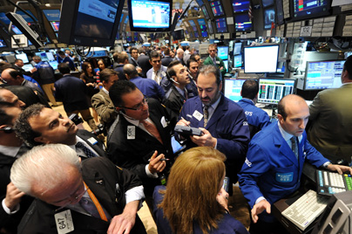
Speculators
There are also people who use the Futures Market to increase their risk in the hopes that they will be able to make extra money as a result.
  Someone who uses the Futures Market to accept a risk in the hopes of making a profit is called a speculator.
  Speculators usually don’t
  trade commodities; they
  trade the contracts for
  those commodities.
Source: thebestaffiliateever.com

Slide 15
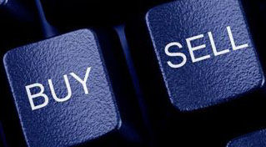
Going Long or Short
Speculators can either “go long” or “go short”.
  If a speculator purchases a contract in the hopes of later selling that contract at a higher price, this is known as going long.
  If a speculator sells a contract with the intention of buying it back at a lower price, this is known as going short.
    Going short allows a speculator to profit as easily from declining prices (by selling high and then buying low) as it is from increasing prices (by buying low and selling high).
As long as the speculator sells after they buy (or buys after they sell) before the date of the contracted sale, they don’t actually have to deliver on the contract.
  For example, if the speculator
  purchases a contract to purchase
  5000 bushels of corn, they would
  have to sell that contract before
  the contracted date.
Source: samuraitradingacademy.com

Slide 16
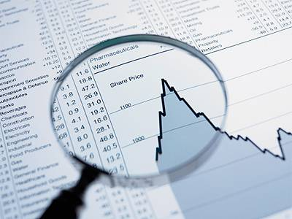
Commodity Contracts
There are two types of futures contracts.
The first is a physical contract, which is the kind that provides for the actual delivery of a commodity.
  This kind of contract has a final date in which the contract is completed; e.g. a July futures contract would need delivery of a commodity in exchange for cash in July.
  This is the kind of contract that
  a speculator would have to
  offset prior to the delivery date
  (e.g. sell it by July if they bought
  the contract previous to July).
Source: http://economictimes.indiatimes.com/photo/29162348.cms

Slide 17
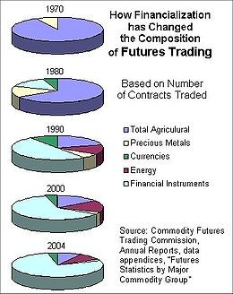
Cash Settlement Contracts
The second kind of contract is a cash-settlement contract.
  These are contracts that are settled for cash rather than the delivery of a commodity.
  Rather than deliver 5000 bushels of corn, the person losing money in the contract will physically pay the amount they lost to the other person who gained from the contract.
Source: http://upload.wikimedia.org/wikipedia/commons/thumb/1/1c/Futures_Trading_Composition.jpg/260px-Futures_Trading_Composition.jpg

Slide 18
Cash-Settlement Contract
For example, imagine that Company A enters a contract to buy 1 million barrels of oil at $70/barrel from Company B in October.
  On the decided date in October, Company A sends $70 million to Company B and Company B sends 1 million barrels of oil.
  However, if the price of oil dropped to $50/barrel (resulting in a difference of $20 per barrel than the contract price), Company A could just send Company B $20 million and no oil would be delivered.
  Or, if the price rose to $80 on the day of the sale, Company B would send $10 million to Company A.

Slide 19
Cash Settlement Contracts
Why would a company choose a cash-settlement contract instead of exchanging the commodity?
  If Company A was only buying the oil just to sell it again, the financial result in price (loss of $20 million or gain of $10 million) would be the same but they would also have to deal with the intricacies and cost of moving a million barrels of oil.
  If the whole point of the contract was to re-sell the commodity (rather than use it for a particular product) it makes more sense just to exchange the money.
  Cash-settlement contracts are ideal for a purchaser who only intends to resell a commodity they purchased because it eliminates the transaction costs.

Slide 20
How Speculating Works
Only a small amount of money is needed to buy or sell a futures market.
  The initial margin is the money a speculator must deposit into their account at the time of placing an order to buy or sell a futures contract.
    For example, it may only cost a speculator $1000 initially to buy $25,000 worth of soybeans contracts.
    The amount needed for an initial margin is determined by the brokerage firm for each futures contract.
  The smaller the margin in relation to the total value of the contract, the greater the leverage of that margin.
Leverage is a measure of the risk of a contract.
  For example, if a contract has high leverage, a small increase can result in large profits for the initial margin.
  However, a small dip for a contract with high leverage could wipe out your initial margin investment.

Slide 21
How Speculating Works
If your investments cause you to lose money and you fall below the amount you invested with your initial margin, you may be asked to add additional funds.
  The maintenance margin is the requirement your futures broker may have as the minimum you need to have in your account in order to trade.
  If the value of your investment falls below the maintenance margin, you will be expected to add more money to your account before you can trade again.
  A request for additional money to meet the maintenance margin is called a margin call.

Slide 22
How Speculating Works
For example, imagine you are required to invest $2000 to buy or sell a particular futures contract.
  The maintenance margin for this contract is $1500.
  If your trading account is reduced to $1400, you will receive a margin call for $600 to restore you back to the initial $2000 investment before you will be allowed to trade again.
It is very important for a speculator to understand the brokerage firm’s Margin Agreement before investing any money.
  If you do not meet the firm’s requirements, they can liquidate any open positions you have at the current market price, causing you to possibly lose even more money than you initially invested and for which you would still be liable.

Slide 23
Trading Strategies
Going Long
  Going long means that you are buying now with the expectation that the price of the contract will increase.
  You intend to buy low and sell high.
  If the price rose at the time of the sale, you’d make money.
  If the price drops at the time of the sale, you’d lose money.
For example, imagine it is January and you see that soybeans are currently quoted at $6.
  You know that demand for soybeans will increase due to poor weather overseas and you expect the price to rise.
  You deposit an initial margin of $1500 to buy one July soybean futures contract of 5000 bushels.
Example from: http://www.orionfutures.com/fut101.htm

Slide 24
Going Long
Now it’s April, and our July soybeans futures contract has risen to $6.40.
  You decide this is good enough and sell you contract.
  Since your contract was originally for 5000 bushels, and the price increased by 40 cents, you just made 5000 x 0.40 = $2000 (not including the transaction costs).
The money you made came from someone who made the opposite decision.
  Someone else expected the price of soybeans to rise, and sold that contract with the intent to buy it back later (“going short”).
  However, once they saw that they weren’t going to make money and they could continue to lose money, they bought back the contract.
  For someone to gain, someone has to lose.
Example from: http://www.orionfutures.com/fut101.htm

Slide 25
Going Long
Imagine you also decided to purchase a July corn futures contract at $6 per bushel for 5000 bushels.
  By April, the price of the contract has dropped to $5.60 and you’re nervous.
  Rather than risk losing more, you sell the contract.
  Because you lost $0.40 per bushel, you now lose $2000 plus your transaction costs.
You also dropped below your maintenance margin.
  Your broker would then call, asking for more money on top of the initial $2000 you lost to return your investment to its maintenance margin.
Example from: http://www.orionfutures.com/fut101.htm

Slide 26
Going Short
If you expected the price of a commodity to drop, you would NOT want to buy now and sell later.
  You always want to buy low and sell high, even if it means you have to sell high and then buy low.
Going short means to sell a commodity first with the intent to buy it back again when it is lower in value.
  For example, imagine that you have reason to believe that the price of cattle will drop in the coming months.
  If this were to happen, you would want to go short for shares of beef.

Slide 27
Going Short
To continue our example, you deposit an initial amount of $2000 in January and sell one contract of April Beef for $0.65 per pound for a total of 40,000 pounds of beef.
  If each contract of beef is for 40,000 lbs., that means that a 1 cent change in the price of beef would result in a gain or loss of $400.
Assume that by March the price has dropped from $0.65 to $0.60 per pound.
  This means that the contract you sold can be bought back for 5 cents less per pound.
  This equates to a $2000 gain (not including transaction costs).
Example from: http://www.orionfutures.com/fut101.htm

Slide 28
Going Short
However, if you were wrong, and the price rises, then you would lose money.
  This is because you would be buying the contract at a higher price than you sold it for.
    Always buy low and sell high.
For example, if the price of beef increases by 70 cents per pound by March on you April contract, you would lose 5 cents per pound.
  This would mean that for a 40,000 contract, you would lose $2000.
  This would wipe out your original investment (the initial margin) and require a maintenance margin to return your account to its original balance (in order to allow you to trade again).
Example from: http://www.orionfutures.com/fut101.htm

Slide 29
Participating as a Speculator
You have many options for participating in the futures market.
  If you are a hedger, you are using the market to guarantee a certain price in the near future.
    You could be a producer who is trying to ensure you can sell your product for a guaranteed price.
    You could also be a purchases trying to find a commodity for a low price.
  If you are participating as a speculator, you are trading contracts (not commodities) and using the risk of this to try to make money.
    As a speculator, you could trade your own account, have someone else manage your account, use a trading advisor, or joining commodities pool.

Slide 30
Speculating Options
Trade your own account: this means that you will be opening your own individual trading account.
  Most major brokerage firms will have services that allow for this.
  All brokerage firms conducting futures business with the public must be registered with the Commodity Futures Trading Commission (CFTC).
Have someone manage your account: this means that you have your own individual account, but an account manager has the legal right to make decisions about when to trade and what to trade.
  You are still responsible for any losses, and you receive any gains, but you are in effect paying another person t make all your decisions for you.
  Usually the amount of money needed to open an account is greater under this method of speculating. Fees will also be higher because you are paying someone to make informed decisions for you.

Slide 31
Speculating Options
Use a Commodity Trading Advisor: this involves an individual that provides advice on commodity trading including specific suggestions such as when to establish or long or short position on a specific commodity.
  You still have to open your own individual account, but you are using a paid advisor to guide your decision making (rather than either making the decisions alone or giving someone else the power to make those decisions for you).
Commodity Pools: this is an option that is similar to a mutual stock fund.
  In this case, you pay into a pool where your money is combined with that of all other pool participants.
  Your combined money is traded as one single account and you share the profits or losses.
  The pool is run by a Commodity Pool Operator; this could be an individual who works for a brokerage firm or is operated independently.
  The risks are the same as individual trading but your risk of loss is generally limited to your investment in the pool – this is because the pool is limited partnership preventing you from being subject to a margin call.

Slide 32
Establishing an Account
If you wish to establish an account with a brokerage firm, they will need your name, address, and phone as well as your income, net worth, previous investment records, and other possible information related to the risk involved with accepting you as a client.
  It is up to the firm to determine if you are a potential risk to their business before they make a decision to take you on.
  The firm will also have to provide you with risk disclosure information as well as their federal certification to make trades in the futures market.
Opening a futures account is a serious decision – just as serious as any financial investment such as a loan or insurance policy.
  Not all firms offer identical services or identical charges for their services.
  Not all clients have the same needs.
  If is important to determine the brokerage firm’s ability to meet your needs at a reasonable price before signing any paperwork.

